Slide 1
School Funding & Compliance Updates
Maine ASBO
September 23, 2022

Slide 2
School Finance Team

Slide 3
School Finance Team
Where is Tyler Backus?
Where is Joanne Allen?

Slide 4
Why EPS?
The EPS formula provides the state with a mechanism for establishing a minimum sufficient funding level for achieving the state learning results and an equitable way to distribute the funding responsibility between local communities and the state.

Slide 5
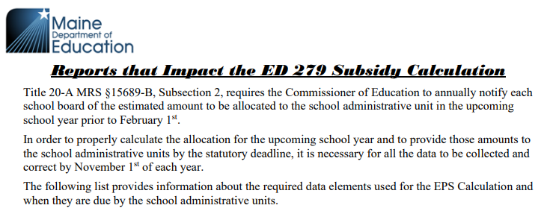
Reports that Impact the ED 279 Subsidy Calculation

Slide 6
Reports that Impact the ED 279 Subsidy Calculation
Type of Reporting | Description |  | Due Date
Staff Reporting
NEO Staff | Current Year Staff Information |  | November 15
Staff Information System | All staff including CTE, but especially those that impact the calculation of EPS Subsidy
Student Enrollment Reports as of October 1st
Synergy Student Data | EPS October 1st Enrollment/Special Education (EF-S-05) including: |  | Uploaded by October 15
 | Attending Students | Resident/Subsidizable Students
NEO Student Reports | Economic Disadvantaged Status | English Learner Status | Certified October 16-30
 | Equivalent Instruction (Home School) | Special Education Status
 | Superintendent Agreements | CTE Enrollment
EFM-39A | Adult Education report for 16 to 20 Year old’s – January thru June |  | July 15
EFM-39B | Adult Education report for 16 to 20 Year old’s – July thru December |  | December 15
Financial Reporting
Prior Year Actuals | Prior Year – Year End Q4 Actual Expenditures, Revenues, Balance Sheet |  | August 30
Current Year Budgets | Current Year – Revenues and Expenditures |  | August 15
EF-M-46/EF-M-46V | Current Year Budget & Reporting of Appropriations for RSU/SAD/CSD/CTE |  | August 15
EF-S-07 | Prior Year Special Education Tuition & Board Report |  | October 15
EF-S-214 | Current High Cost Out-of-District Placement Adjustment Report |  | April 15
EF-M-43 | Prior Year Transportation Costs for Out-of-District Special Education, Homeless, CTE |  | N/A
Annual Audit | Prior Year Annual Audit Report |  | December 31
Other Reports
MaineCare Seed | Quarterly MaineCare Seed Recovery Report Verification for Public & Private Placements |  | July 15 October 15 January 15 April 15

Slide 7
Student Data Needs
October 1st Enrollment Report (Public Schools & CTE):
Attending Students – those student attending a school in your district
Resident Students – those students that reside in a town in your district
Superintendent Transfer Students – those students that reside in a town outside of your district, but for purposes of the EPS calculation will be counted as a resident of your district.
Equivalent Instruction Students – Home School students taking a course(s) in your district.
Economic Disadvantaged Students – Currently defined as any student that meets the qualifications for federal free or reduced lunch.
FY23 Alternate Economic Disadvantaged Status Form (updated 3/2/2022)
English Learners – students that are identified as English learners.
Special Education Students – students identified as special education students.
CTE Enrollment – Students enrolled in CTE programs.
Synergy – State’s Student Information System
https://www.maine.gov/doe/data-reporting/collection/helpdesk/resources/synergy_instructions

Slide 8
Estimated counts
PreK estimated counts
For new programs in FY2024 estimated counts are due by November 30th
This includes programs paid for with any federal funds
All programs must be approved by the Early Childhood program
Charter school estimate counts
Expanding charter schools (new buildings or additional grades) estimates due by November 30th
Note: All estimate student counts will be reconciled after the collection of the Oct. 1st counts in the next fiscal year.

Slide 9
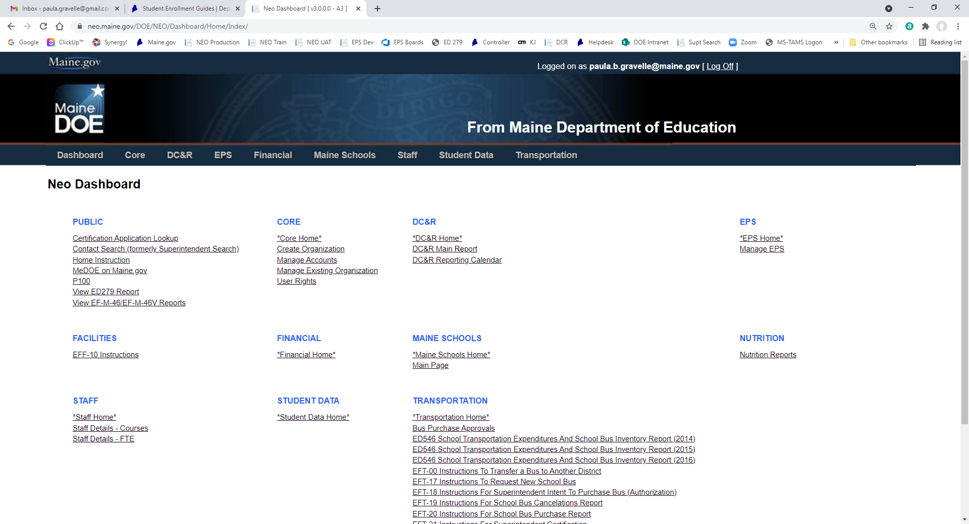
Student Data Verification
NEO – New Education Ontology (yes, someone liked the Matrix)
https://neo.maine.gov/DOE/NEO/Dashboard/Home/Index/
Click Here

Slide 10
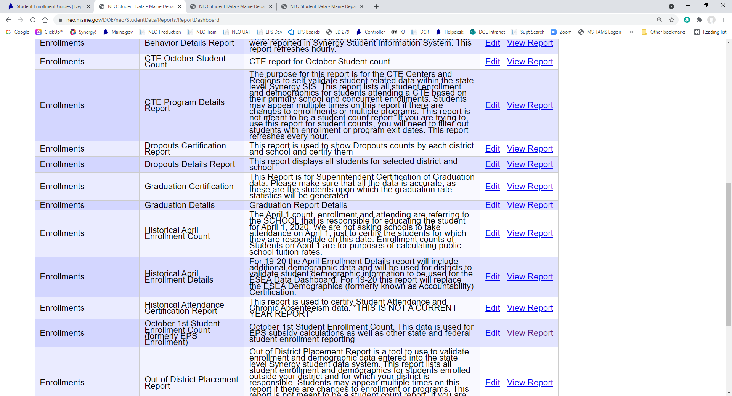
Student Data Verification
Student Reports
Click Here

Slide 11
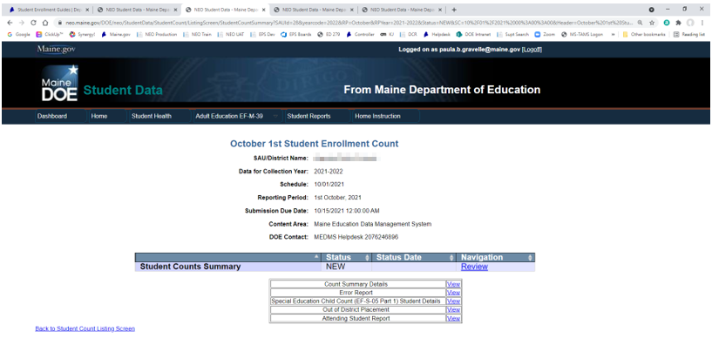
Student Data Verification

Slide 12
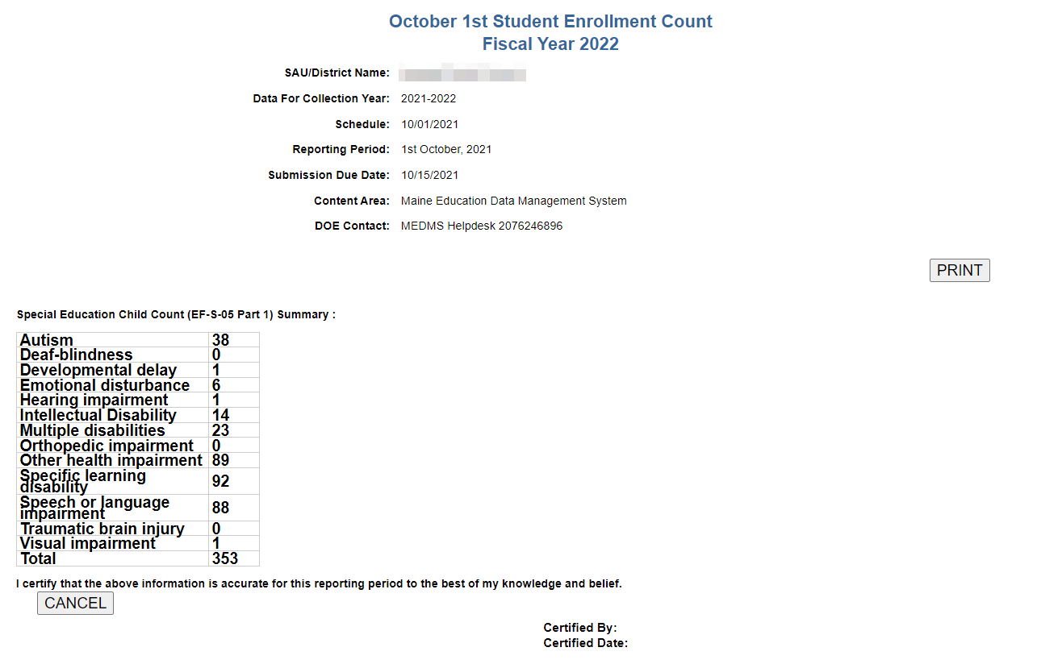
Student Data Verification

Slide 13
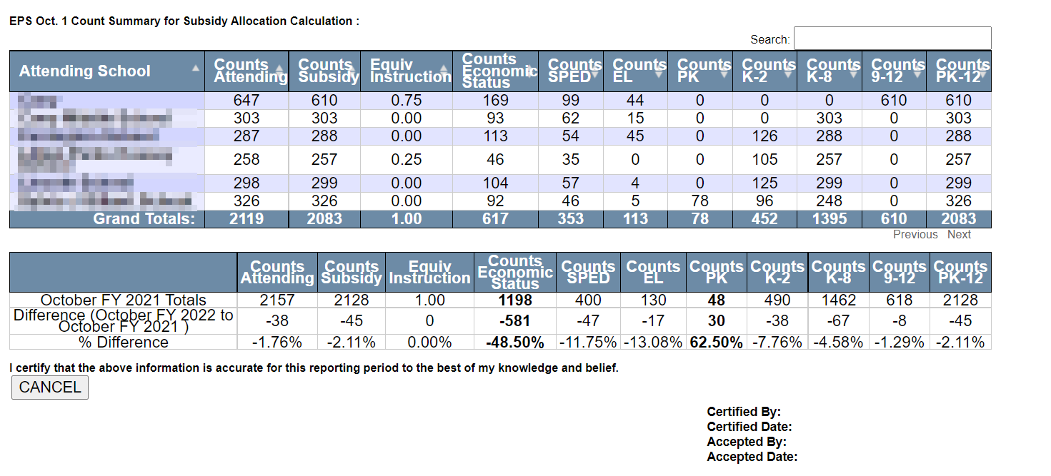
Student Data Verification

Slide 14
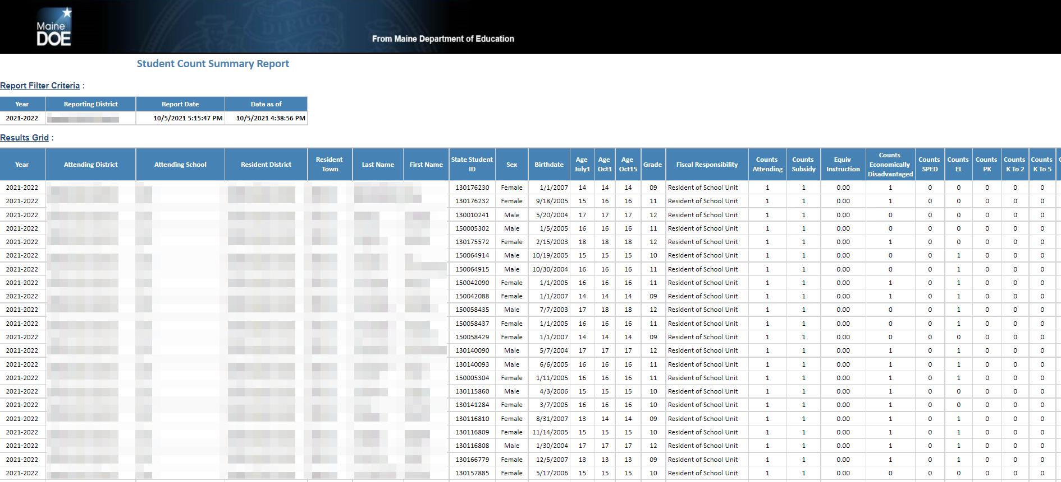
Student Data Verification – Count Summary Details Report

Slide 15
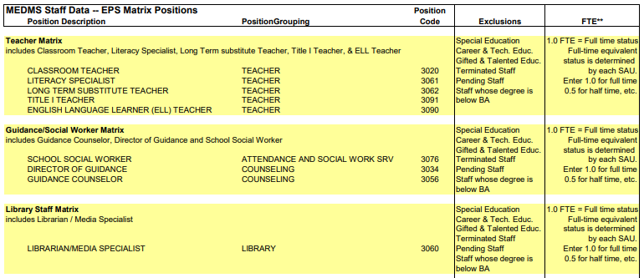
Staff Data Needs

Slide 16
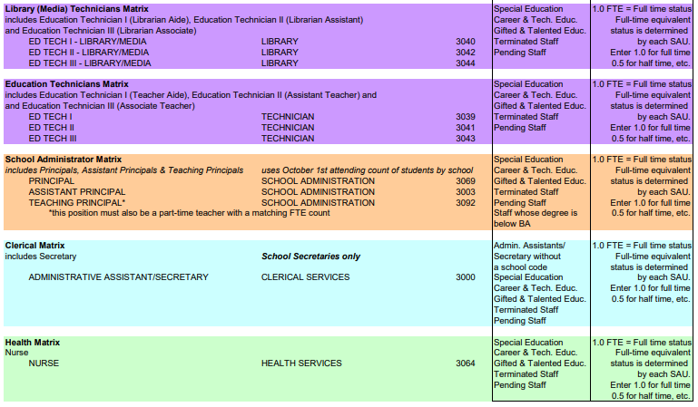
Staff Data Needs

Slide 17
Staff Data Verification
NEO – New Education Ontology (yes, someone liked the Matrix)
https://neo.maine.gov/DOE/NEO/Dashboard/Home/Index/
Click Here

Slide 18
Staff Data Verification
Click Here

Slide 19
Staff Data Verification
Click Here

Slide 20
Staff Data Verification
Compare the current year EPS Staff totals to the prior year ED 279 Section 1 Actual FTE Totals

Slide 21
Staff Data Verification
Click Here

Slide 22
Data for EPS funding - Financial
Financial data
Actual expenditures
Actual revenues
Actual balance sheet
Unaudited expenditures were due August 30th
Reconciliation & Statement of assurance due by November 1st
Audited financials due by November 30th

Slide 23
Quarterly MEFS uploads
Quarterly uploads are due to MEFS
Q1 actuals due (migrated) between October 1st & December 31s
Q2 between January 1st and March 31st
Q3 between April 1st and June 30th
Report used for federal relief funds and child nutrition quarterly reporting

Slide 24
Data for EPS funding - Financial

Slide 25
Other reports
MaineCare
Ensure the district is reviewing the quarterly MaineCare reports so that only seed the districts is responsible for is removed from subsidy
EF-S-07 Report
Out of District Special Education Tuition and Board (EF-S-07) is required for each SAU & is due October 15.
FY2023 budgets
All initial budget files should be migrated no later than October 31st
Audits
School and combined audit due by December 31st
Municipals audits due 6 months after fiscal year ends

Slide 26
Impact of Data Errors in the Subsidy Calculation
Data Error – Staff | Subsidy $
1 FTE Ed Tech not identified as Special Ed | $735.35
3 FTE Health Staff incorrectly identified as Special Ed | $24,230.11
.5 FTE Librarian & .2 FTE Health did not count for EPS | $10,831.52
Teacher incorrectly listed with Bachelor’s Degree, has Master’s Degree | $5,661.60
Data Error – Students | Subsidy $
34 Students not identified as English Learners | $113,044.05
3 Students not identified as Economic Disadvantaged | $1,473.84
24 Students not identified as Economic Disadvantaged | $42,512.27
132 Students not identified as Economic Disadvantaged | $1,093,873.50
58 Adult Education Courses missing from EF-M-39 A & B | $42,780.80

Slide 27
Impact of Data Errors in the Subsidy Calculation
Data Error – Financials | Subsidy $
Gifted & Talented Expenditures not uploaded in MEFS | $2,755.00
Gifted & Talented Expenditures not uploaded in MEFS | $20,000.00
Special Education High Cost Out-of-District Reporting Error | $4,995.92
Data Error – CTE | Subsidy $
Supplies incorrectly listed as Equipment in budget | $15,000.00
Additional Square Footage not reported | $56,739.95

Slide 28
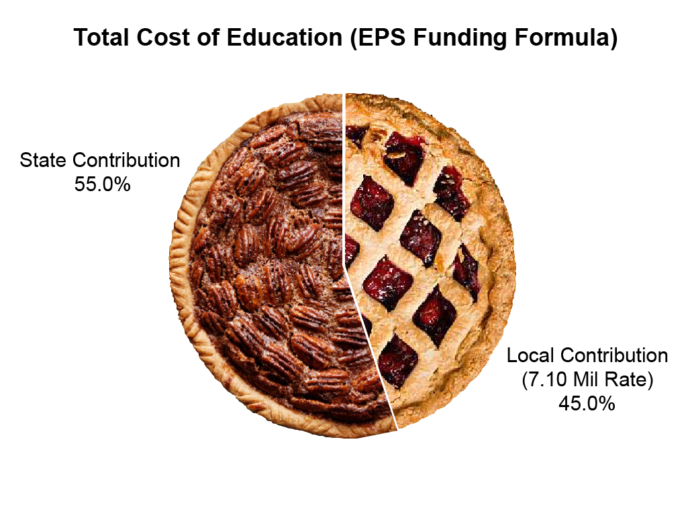
State and Local Shares – ED 279 Section 4
Total Cost of Education FY 23 EPS Calculation = $2,461,557,483
FY 23 State Appropriation for Education = $1,357,197,032

Slide 29
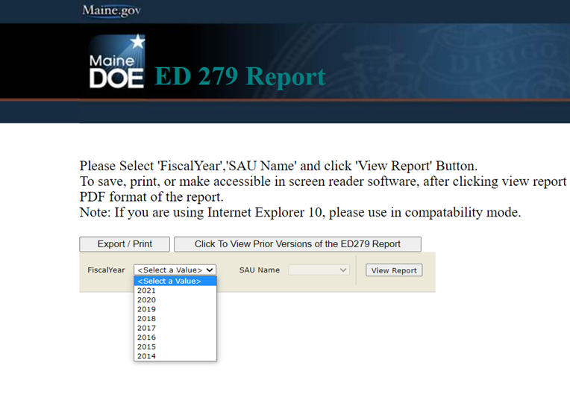
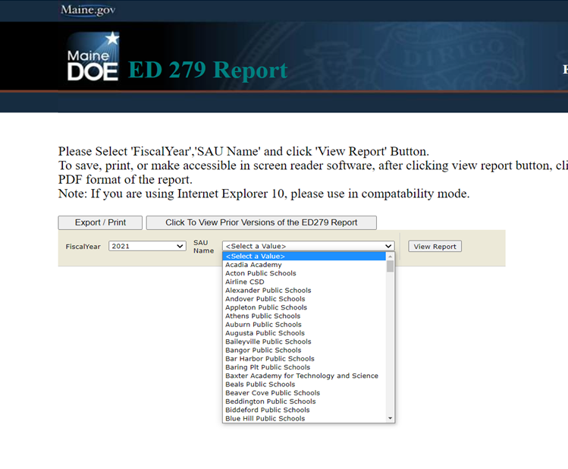
How do I access the ED 279 reports? Go to https://neo.maine.gov/DOE/NEO/eps/public/ed279.aspx
Choose Fiscal Year:
Choose SAU:

Slide 30
Other Resources
Essential Programs & Services website:
https://www.maine.gov/doe/funding/gpa/eps
Subsidy Printouts (ED279) for school districts:
https://neo.maine.gov/DOE/NEO/eps/public/ed279.aspx
Law: 20-A MRSA Chapter 606-B:
http://www.mainelegislature.org/legis/statutes/20-A/title20-Ach606-Bsec0.html

Slide 31
Maine DOE – Help Desk Website
https://www.maine.gov/doe/data-reporting/collection/helpdesk

Slide 32
School Finance Team Contact Information

