Slide 1
Elementary & Secondary Education Act (ESEA) Team Overview
Maine ASBO Meeting
11/04/22
Notes:
Cheryl

Slide 2
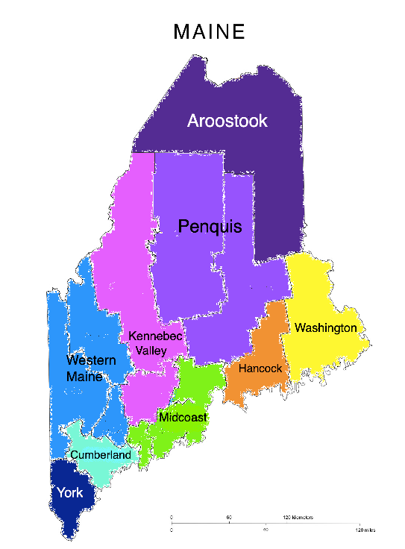
Regional Program Management
Provides a primary ESEA contact for each school district
  Questions & Support
  Application & Performance Report Review
Offers well-rounded knowledge base
Increases the Department’s capacity to support districts
Notes:
Cheryl

Slide 3
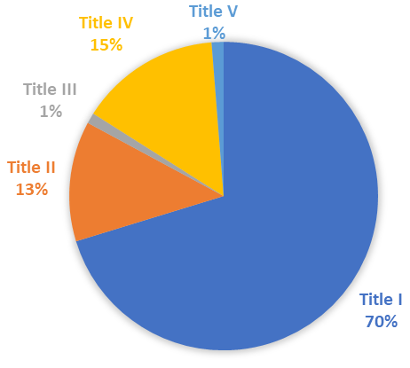
Maine’s ESEA Funding Levels
Program | FY23 Allocations
Title I | $59,492,429.00
Title II | $10,671,833.00
Title III | $945,276.00
Title IV | $12,496,358.00
Title V | $1,058,735.00
Total | $84,664,631.00
Notes:
Jess

Slide 4
Title I
Part A: Improving the Academic Achievement of the Disadvantaged
  Formula grant for eligible school districts designed to assist schools with high poverty rates in ensuring all children meet challenging state academic standards
    Academic Support & Intervention Programs
    Professional Development
    Parent and Family Engagement
  Schoolwide vs Targeted Assistance Programs
  Title I, Part A Spending Snapshot
Notes:
Set-aside requirements: Family Engagement (over $500k),
Homeless project (all), 7% for School Improvement

Slide 5
Title II
Part A: Increasing Teacher & Principal Quality
  Formula grant for eligible school districts that supports:
    Professional Development & Coaching
    Class Size Reduction
    Evaluation
    Recruitment & Retention
    Multiple Pathways to Teaching and Leading
  Title II, Part A Spending Snapshot
Notes:
Ryan

Slide 6
Title III
Part A: Language Instruction for English Learners and Immigrant Students
  Formula grant to eligible school districts designed to provide supports for multi-lingual learners in the following areas:
    Supplemental Language Instruction Programs
    Professional Development
    Parent, Family, and Community Engagement
  Separate $20,000 grant available to support the district with highest increase in enrollment of immigrant children and youth
  Title III, Part A Spending Snapshot
Notes:
Dan

Slide 7
Title IV
Part A: Student Support & Academic Enrichment
  Formula grants to eligible school districts supporting:
    Well-rounded educational opportunities
    Student health and safety
    Use of technology to enhance student learning
  Title IV, Part A Spending Snapshot
Part B: 21st Century Community Learning Centers
  Competitive grants to districts, CBOs, FBOs, etc. supporting:
    Comprehensive school-year and summer educational programs that are provided during non-school hours
  21st CCLC Program RFP
Notes:
Travis

Slide 8
Title V
Part B, Subpart 2: Rural & Low-Income School (RLIS)
  Formula grant awards to eligible school districts designed to provide supplemental funding to meet the unique needs of rural schools
    Grant funds may be leveraged for any expense or activity that would be allowable under the other ESEA Programs (i.e. Title I, Title II, Title III, and/or Title IV)
Notes:
Dan

Slide 9
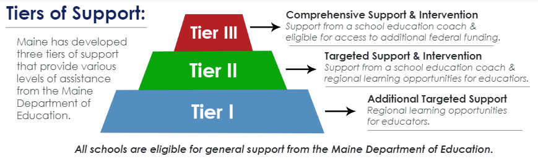
Maine’s Model of School Support
Providing additional support to schools facing significant & on-going challenges, including:
  Supplemental funds that do not supplant other ESEA funds
  Maine DOE School Leadership Coach
  FREE Maine DOE Professional Learning Opportunities
Notes:
Renee

Slide 10
Tier III School Improvement
Separate Funding Application in Grants4ME
  School-specific applications; only for Tier III Schools
  Period of Availability: Application Approval Date – 9/30
    Example: 10/1/22 - 9/30/23
    No Carryover Period for School Improvement Funds
Funding supports Professional Development Needs:
  Allowable
    Salaries & Benefits
    Instructional Supplies
      Must be required for staff participation
    Travel
    Purchased Services
  Reasonable & Necessary
    Specifically outlined in Approved Strategic Plan Application
Notes:
Renee/Cheryl

Slide 11
Grants4ME
Maine’s online Grant Management System used for submitting, reviewing, and processing:
  Applications
  Reimbursement Requests
  Performance & Close Out Reports
URL: https://maine.egrantsmanagement.com/
Business Managers should have a unique login as well as the “LEA Fiscal Representative” role
https://www.maine.gov/doe/learning/esea/grants4me
Notes:
Ryan

Slide 12
ESEA Application
Submission Deadline: August 1st (annually)
Application Submission Workflow
  ESEA Application Workflow Guide
“LEA Fiscal Representative Approved”
  Review of “Budget Overview” page for each Title Program
    Make sure this aligns to local accounting records
    Accounting Handbook for Maine SAUs
  Download Grant Award Notifications (GANs) for each Title Program
  Business Managers may approve or reject an application
Notes:
Dan

Slide 13
ESEA Reimbursement Requests
Substantial Approval Date = 1st Date of Obligation
Follow statutory regulations & district policies
  Federal Title Programs Spending Handbook
  2 CFR 200
ESEA Reimbursement Request Workflow
  Step 1: District submits request in Grants4ME
  Step 2: ESEA Team reviews submissions
  Step 3: State Service Center reviews submissions
  Step 4: State issues payments to districts
Notes:
Tyra

Slide 14
ESEA Reimbursement Requests Continued
Supporting Documentation
  1st reimbursement request for the approved funding application
    Detailed Trial Balance or Profit & Loss Statement
    Time & Effort Certifications (at least 2-3 staff members)
    Receipts and/or invoices for all expenditures
  All subsequent reimbursement requests
    Required: Detailed Trial Balance or Profit & Loss Statement for the corresponding billing period
    Upon Request: Any additional supporting documentation needed to verify expenses
Notes:
Tyra

Slide 15
ESEA Performance Reports
Submission Deadline: November 1st (annually)
Content:
  Reporting on program outcomes, project-based expenditures, and supplemental information
Reporting Period:
  Date of Substantial Approval through 9/30 of following year (Example: 8/1/22 – 9/30/23)
  All ESEA billing for the grant period must be completed through 9/30 BEFORE completing the Performance Report
Carryover invoices with a service period beginning 10/1 or later will be held until the Performance Report is approved
Notes:
Travis

Slide 16
ESEA Close Out Reports
Submission Deadline: November 1st (annually)
Content:
  Reporting final project-based expenditures
Report Period:
  Carryover period for ESEA funding
  (Example: 10/1/23 – 9/30/24)
  End date for reporting period is subject to change
    U.S. DOE Tydings Amendment Waivers can add 12 months to the carryover period (Example: 10/1/23 – 9/30/25)
Notes:
Travis

Slide 17
Recommendations for Success
Establish & maintain a good working relationship with the district’s ESEA Coordinator
  Set up recurring check-in meetings to discuss grant applications, expenses, reporting, etc.
Follow best practices when submitting invoices
  Do not exceed a 3-month billing period
  Provide correct documentation to support expenses
Review trainings & resources on the MDOE website
  Grants4ME Training & Resource Documents
  ESEA Federal Spending Handbook
  Accounting Handbook for Maine SAUs
Notes:
Tyra

Slide 18
?
Questions
Notes:
Rita

Slide 19
ESEA Team Contacts
ESEA Federal Programs Director cheryl.lang@maine.gov 207-441-8059 | School Improvement Coordinator renee.a.reilly@maine.gov 207-816-0572 | Management Analyst tyra.corson@maine.gov 207-530-0488
Aroostook jessica.s.caron@maine.gov 207-458-0334 | Penquis travis.w.doughty@maine.gov 207-624-6709 | Washington ryan.reed@maine.gov 207-530-2129
Hancock rita.pello@maine.gov 207-530-6469 | Kennebec jessica.s.caron@maine.gov 207-458-0334 | Western daniel.r.weeks@maine.gov 207-624-6749
Cumberland daniel.r.weeks@maine.gov 207-624-6749 | Midcoast ryan.reed@maine.gov 207-530-2129 | York rita.pello@maine.gov 207-530-6469
Notes:
Cheryl

