Slide 1
Maine ASBO Updates March 3, 2023

Slide 2
Updates
Federal Emergency Relief
Elementary and Secondary Education Act (ESEA)
Legislation
State Budget
Essential Programs and Services
Questions

Slide 3
Federal Programs
ESEA Dashboard
ESSER Dashboard
Reimbursement
Title IA
Allocations
Summer School Reallocation

Slide 4
Legislation
LD 33, An Act to Expand Access to CTE Opportunities for Middle School Students
LD 79, An Act to Ensure a High-quality Education for Students with Disabilities by Clarifying the Definition of "State Agency Client" and Who Provides Special Education Programs and Service
LD 98, An Act to Update the Special Education Laws
LD 889, An Act to Better Support the Educational Attainment of Low and Moderate-income Communities by Providing Additional Funding to Certain School Administrative Units

Slide 5
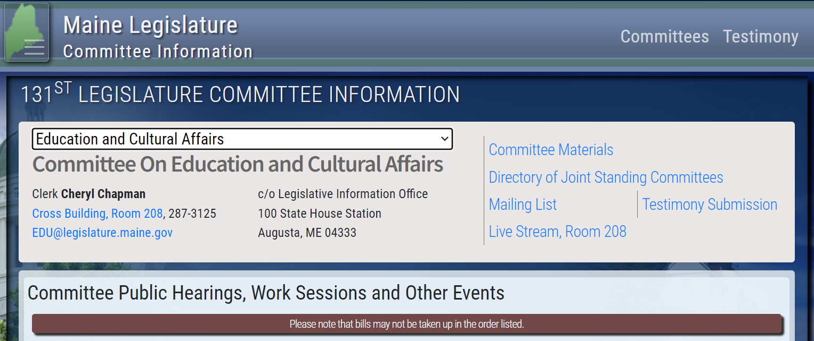
Legislation
To access legislative committee hearings, navigate to legislature.maine.gov/#committee
Select the drop down menu to choose a committee and listen live.

Slide 6
Essential Programs and Services (EPS)
Governor’s Budget Proposal maintains support for the 55% state share of the cost of education
LD 258, An Act Making Unified Appropriations and Allocations from the General Fund and Other Funds for the Expenditures of State Government and Changing Certain Provisions of the Law Necessary to the Proper Operations of State Government for the Fiscal Years Ending June 30, 2023, June 30, 2024, and June 30, 2025

Slide 7
School Finance Basics EPS FY 24 Recommended Funding Level Updates

Slide 8
School Finance Basics
Oversight of Public-School State Funding
1. Calculation of state funding
2. Distribution of state funding
3. Accountability of state funding

Slide 9
Calculation: EPS Formula
Essential Programs and Services
Title 20-A, Chapter 606-B: ESSENTIAL PROGRAMS AND SERVICES
The EPS formula provides the State with a mechanism for establishing a minimum sufficient funding level for achieving the Learning Results and an equitable way to distribute the funding responsibility between local communities and the State.

Slide 10
EPS Goal = Equitable Distribution

Slide 11
Calculation: EPS Formula
Essential Programs and Services (EPS) is designed to ensure that all schools have the programs and resources that are essential for all students to have an equitable opportunity to achieve Maine’s Learning Results.
The EPS model provides a basis for adequacy and greater equity in the funding of PreK-12 education because it is mostly cost driven instead of expenditure driven.
The model is designed to respond to student needs and is based on years of research and information gleaned from high performing cost-effective school units.

Slide 12
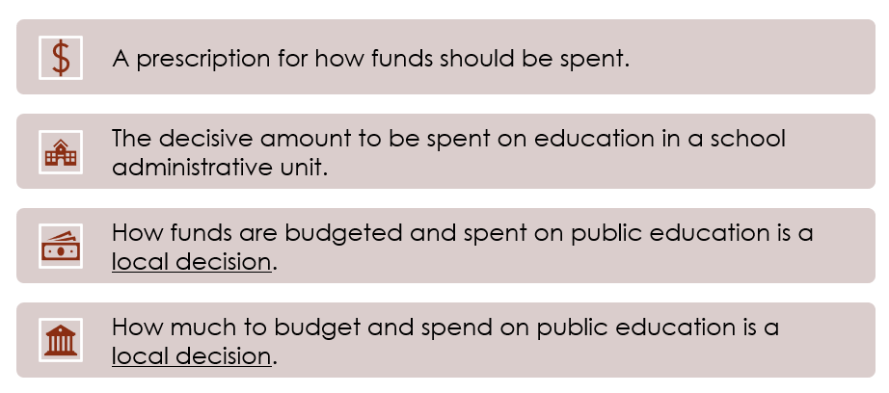
Calculation: EPS Formula
What EPS is NOT:

Slide 13
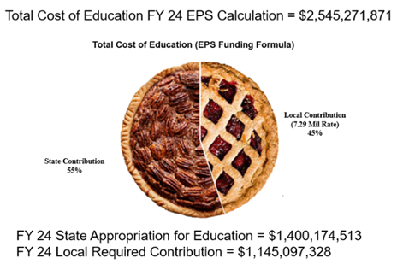
Calculation: EPS Formula
How Much Pie Do We Need?

Slide 14
Calculation: EPS Formula
Key Operating (Cost Driven) Components:
Student Demographics (Pupil counts by SAU & grade level)
EPS Per Pupil Rate for each Individual SAU (Per pupil amounts are tailored for each unit reflecting costs for actual Staff)
Weighted Amounts (Additional funding for English (Multilingual) Learners and those identified as Economically Disadvantaged)
Targeted Amounts (Additional funding for PreK, K-2, Assessments, and Technology Resources)
Other Adjustments (include additional funding for Isolated Small Schools, Adult Education, and Equivalent Instruction)

Slide 15
Student Data Needs
October 1st Enrollment Report (Public Schools & CTE):
Attending Students – those student attending a school in your district
Resident Students – those students that reside in a town in your district
Superintendent Transfer Students – those students that reside in a town outside of your district, but for purposes of the EPS calculation will be counted as a resident of your district.
Equivalent Instruction Students – Home School students taking a course(s) in your district.
Economic Disadvantaged Students – Currently defined as any student that meets the qualifications for federal free or reduced lunch.
English Learners – students that are identified as English learners.
Special Education Students – students identified as special education students.
CTE Enrollment – Students enrolled in CTE programs.
Synergy – State’s Student Information System
https://www.maine.gov/doe/data-reporting/collection/helpdesk/resources/synergy_instructions

Slide 16
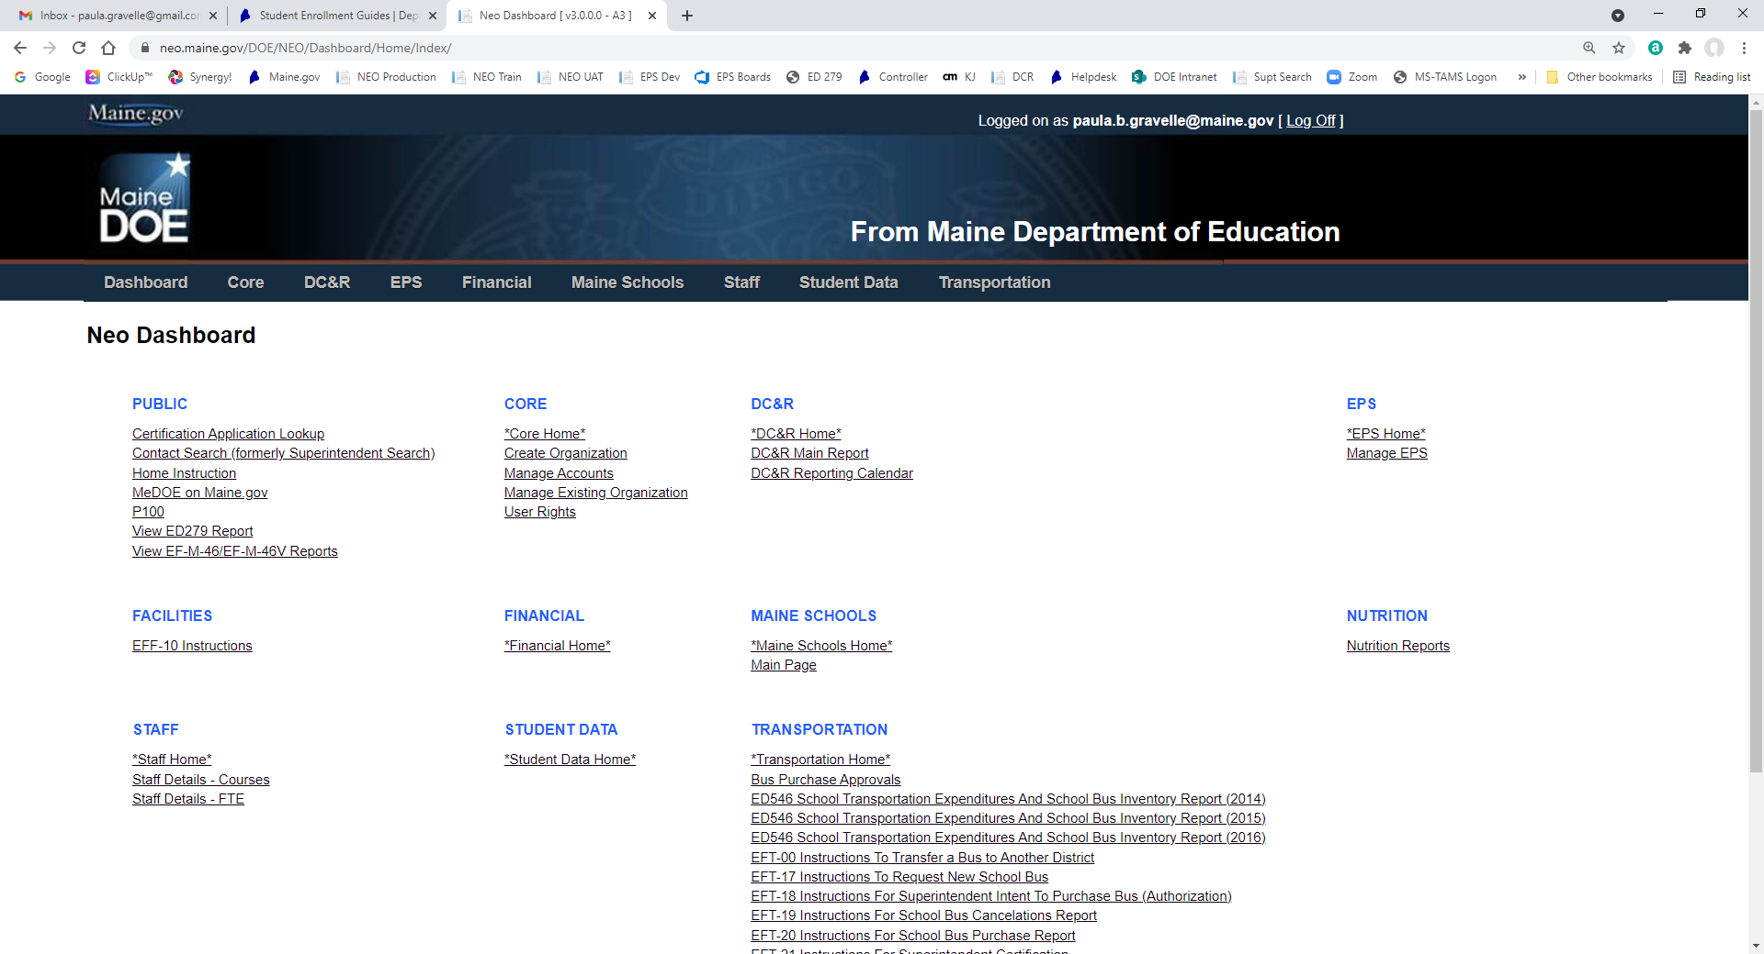
Student Data Verification
NEO – New Education Ontology (yes, someone liked the Matrix)
https://neo.maine.gov/DOE/NEO/Dashboard/Home/Index/
Click Here

Slide 17
ED 279 - Section 1
Data for Section 1
Attending student counts
Staff
Teachers
Classroom Teacher, Literacy Specialist, Long-term substitute, Title I Teacher, EL Teacher
Guidance
School Social Worker, Director of Guidance, Guidance Counselor
Librarians
Health
Education Techs
Library Techs
Clerical
Building level
School Admins
Principal, Assistant Principal, Teaching Principal
Notes:
Special Education and CTE staff are not included in any the staff FTEs for Section 1.

Slide 18
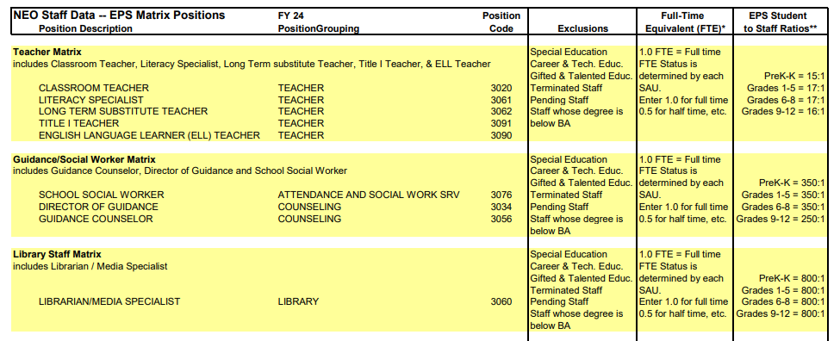
Staff Data Needs

Slide 19
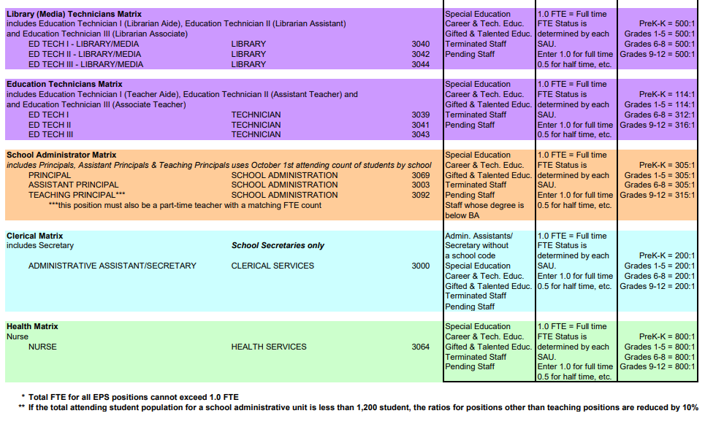
Staff Data Needs

Slide 20
Staff Data Verification
NEO – New Education Ontology (yes, someone liked the Matrix)
https://neo.maine.gov/DOE/NEO/Dashboard/Home/Index/
Click Here

Slide 21
Staff Data Verification
Click Here

Slide 22
Staff Data Verification
Click Here

Slide 23
Staff Data Verification
Click Here

Slide 24
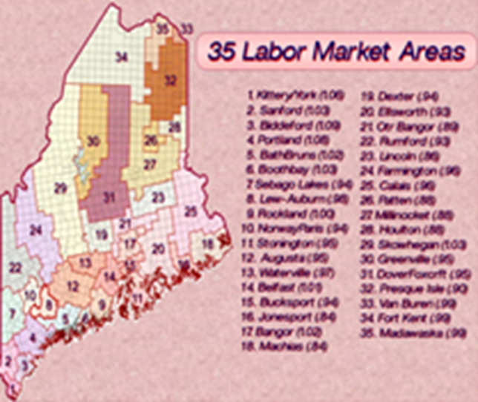
EPS Per-Pupil Rates – ED 279 Section 1
Regional Adjustments
The regional index is a factor using the 35 Labor Market Areas to account for variations in Income Levels and the Cost of living throughout the State of Maine; and the fact that we are using an Average Salary Scale for the entire State when determining the amount of salary to allow in the EPS calculation.

Slide 25
ED 279 – Section 2
Data for Section 2
Subsidy student
PreK, K-2, K-8, 9-12
Adult Education students
Equivalent Instruction students
Economically Disadvantaged students
English Learners
Isolated Small Schools

Slide 26
Calculation: EPS Formula
Other Subsidizable (Expenditure Driven) Components:
Special Education
Transportation
Gifted & Talented
Bus Purchases
School Construction Debt Service

Slide 27
ED 279 - Section 3
Gifted & Talented
Budget versus actual expenditures
Special Education
Subsidizable students, special education students, state agency clients, foster care students, actual expenditures and revenues
Special Education HCOOD
EF-S-07, actual expenditures
Transportation
Actual expenditures and revenues, previous year allocation
Approved Buses
Bus approvals, actual expenditures

Slide 28
Calculation: EPS Formula
State and Local Share:
In order to receive State subsidy, SAUs must contribute the required local amount per the EPS calculation.
Many SAUs raise above and beyond what the State requires for the local share – that is referred to as "additional local".
Key Factors in Determining Required Local Share:
Valuation by town as provided by the Maine Revenue Service each year, which determines ability to pay
Percentage of students by town within a combined SAU, used to determine distribution of Total Allocation by Town
Mil Expectation calculated after determining Total Cost of Education, State Funds Available, and Valuation by Town.
Current FY 24 Mil Rate = 7.29

Slide 29
ED 279 – Section 4
Distribution of Allocation
Resident students by town
Operating, Other Subsidizable, and Techer Retirement Allocation
Debt service by town
State valuation by town
Valuations of past 3 years
Uses either most recent or 3 year average, whichever is less

Slide 30
ED 279 – Section 5
Section 5a
Adjustments to state subsidy and local allocation
Special education, minimum subsidy, debt service, economically disadvantaged
Section 5b
Adjustments to state subsidy
Career & Technology Centers, Education Service Centers, MaineCare Seed
Section 5c
Local and state share %
Section 5f
Adjusted local contribution by town

Slide 31
Adjustments – ED 279 Section 5
List of adjustments where applicable:
Minimum State Allocation Adjustment (5%) (Minimum Receiver)
Minimum Special Education Adjustment (50%) (Minimum Receiver)
Adjustment for Debt Service (Minimum Receiver)
Minimum Economically Disadvantaged Student Adjustment (Minimum Receiver)
Audit Adjustments
Adjustment for Unappropriated Local Contribution
Long-Term Drug Treatment Centers Adjustments
Career and Technical Education (CTE)
Education Service Center (ESC) Member Allocation
Minimum Teacher Salary Adjustment
Maine Care Seed Adjustment

Slide 32
Distribution of State Funding
How Big A Slice Does Each SAU Get?​
How to distribute State funds to individual SAUs:
Example SAU: Augusta
Total Cost of Education per EPS = $27,083,361.63
Town Valuation = $1,656,850,000
X Mil Rate Expectation = 7.10
= Local Ability to Pay = $11,763,635.00
Total Cost of Education per EPS for SAU = $27,083,361.63
Minus Local Ability to Pay = $11,763,635.00
Equals State Contribution to SAU = $15,319,726.63

Slide 33
Distribution of State Funding
How Big A Slice Does Each SAU Get?​
How to distribute State funds to individual SAUs:
Example SAU: York
Total Cost of Education per EPS = $21,612,236.37
Town Valuation = $4,704,133,333
X Mil Rate Expectation = 7.10
= Local Ability to Pay = $33,399,346.66
Total Cost of Education per EPS for SAU = $21,612,236.37
Minus Local Ability to Pay = $33,399,346.66
Equals State Contribution to SAU = $0 *
State Contribution after Minimum Receiver Adjustment = $ 2,968,115.81
* This is an example of a Minimum Receiver

Slide 34
Distribution of State Funding
Minimum Receiver Status
When a SAU/town's ability to pay is greater than their required local contribution, then they are considered a minimum receiver.
Remember, the EPS funding formula is used to equitably distribute funds to the areas that need them the most.
As a result, if a SAU has a higher valuation, (aka: higher ability to pay), the EPS formula will provide less funds to you, so it can provide more funds to SAUs that do not have as great an ability to pay.

Slide 35
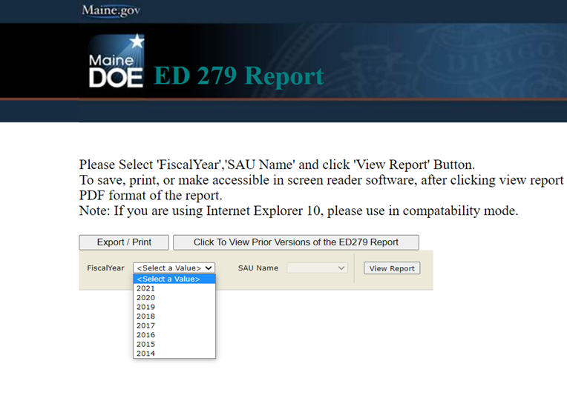
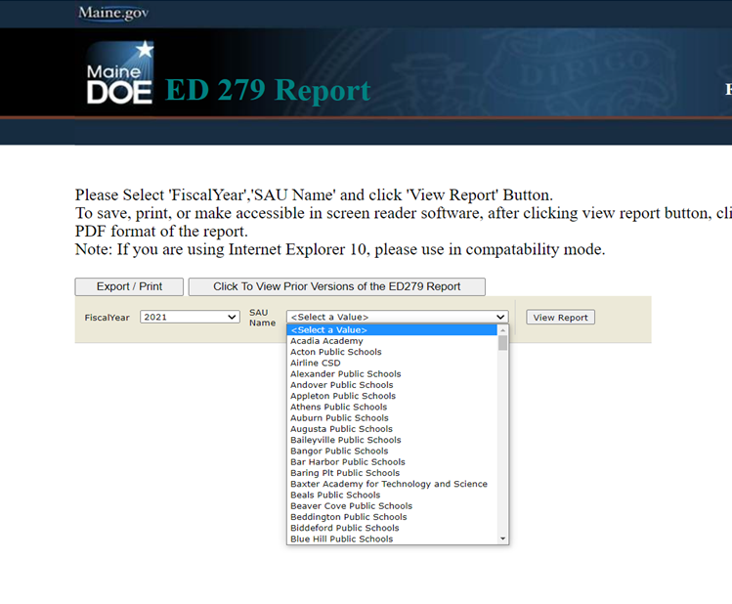
How do I access the ED 279 reports? Go to https://neo.maine.gov/DOE/NEO/eps/public/ed279.aspx
Choose Fiscal Year:
Choose SAU:

Slide 36
EPS Guides – Help Desk Website
EPS Data Deadlines
Reports That Impact Subsidy
Staff FTE Positions
Economically Disadvantaged Status Information
FY23 Alternate Economic Disadvantaged Status Form - Updated 3/2/2022
FY24 Alternate Economic Disadvantaged Status Forms - Updated 3/2/2023

Slide 37
EPS Guides – Help Desk Website
Type of Reporting | Description |  | Due Date
Staff Reporting
NEO Staff | Current Year Staff Information |  | November 15
Staff Information System | All staff including CTE, but especially those that impact the calculation of EPS Subsidy
Student Enrollment Reports as of October 1st
Synergy Student Data | EPS October 1st Enrollment/Special Education (EF-S-05) including: |  | Uploaded by October 15
 | Attending Students | Resident/Subsidizable Students
NEO Student Reports | Economic Disadvantaged Status | English Learner Status | Certified October 16-30
 | Equivalent Instruction (Home School) | Special Education Status
 | Superintendent Agreements | CTE Enrollment
EFM-39A | Adult Education report for 16 to 20 Year old’s – January thru June |  | July 15
EFM-39B | Adult Education report for 16 to 20 Year old’s – July thru December |  | December 15
Financial Reporting
Prior Year Actuals | Prior Year – Year End Q4 Actual Expenditures, Revenues, Balance Sheet |  | August 30
Current Year Budgets | Current Year – Revenues and Expenditures |  | August 15
EF-M-46/EF-M-46V | Current Year Budget & Reporting of Appropriations for RSU/SAD/CSD/CTE |  | August 15
EF-S-07 | Prior Year Special Education Tuition & Board Report |  | October 15
EF-S-214 | Current High Cost Out-of-District Placement Adjustment Report |  | April 15
EF-M-43** | Prior Year Transportation Costs for Out-of-District Special Education, Homeless, CTE **Not collecting this data in FY 22 for the FY 21 school year |  | N/A
Annual Audit | Prior Year Annual Audit Report |  | December 31
Other Reports
MaineCare Seed | Quarterly MaineCare Seed Recovery Report Verification for Public & Private Placements |  | July 15 October 15 January 15 April 15

Slide 38
Impact of Data Errors in the Subsidy Calculation
Data Error – Staff | Subsidy $
1 FTE Ed Tech not identified as Special Ed | $735.35
3 FTE Health Staff incorrectly identified as Special Ed | $24,230.11
.5 FTE Librarian & .2 FTE Health did not count for EPS | $10,831.52
Teacher incorrectly listed with Bachelor’s Degree, has Master’s Degree | $5,661.60
Data Error – Students | Subsidy $
34 Students not identified as English Learners | $113,044.05
3 Students not identified as Economic Disadvantaged | $1,473.84
24 Students not identified as Economic Disadvantaged | $42,512.27
132 Students not identified as Economic Disadvantaged | $1,093,873.50
58 Adult Education Courses missing from EF-M-39 A & B | $42,780.80

Slide 39
Impact of Data Errors in the Subsidy Calculation
Data Error – Financials | Subsidy $
Gifted & Talented Expenditures not uploaded in MEFS | $2,755.00
Gifted & Talented Expenditures not uploaded in MEFS | $20,000.00
Special Education High Cost Out-of-District Reporting Error | $4,995.92
Data Error – CTE | Subsidy $
Supplies incorrectly listed as Equipment in budget | $15,000.00
Additional Square Footage not reported | $56,739.95

Slide 40
Accountability of State Funds
In order to ensure accountability:
All SAUs are required to submit a financial audit annually per Title 20-A, §6051.

Slide 41
2023-2024 Updates to the School Funding Formula
The total cost of education reflects a return to the statutory EPS (Essential Programs and Services) model after 2 years of adjustments designed to support financial stability for Maine Schools during the COVID disruptions which included:
Student-to-Teacher Ratio for the Elementary Level (Grades 1-5) changed from 17:1 to 16:1.
This ratio is now back to the current statutory level of 17:1 beginning with the FY 24 EPS calculation
Student-to-Teacher Ratio for the Middle Level (Grades 6-8) changed from 17:1 to 16:1.
This ratio is now back to the current statutory level of 17:1 beginning with the FY 24 EPS calculation
The additional weight for the Economically Disadvantaged Students was increased from .15 to .20; and the calculation to determine the percentage for each SAU was changed from only using the most recent resident and economically disadvantaged student counts to the highest of the 3 most recent years’ economically disadvantaged percentages.
This weight is now back to the statutory level of .15 beginning with the FY 24 EPS calculation
This percentage is now back to using the most recent year calculation beginning with the FY 24 EPS calculation per statute

Slide 42
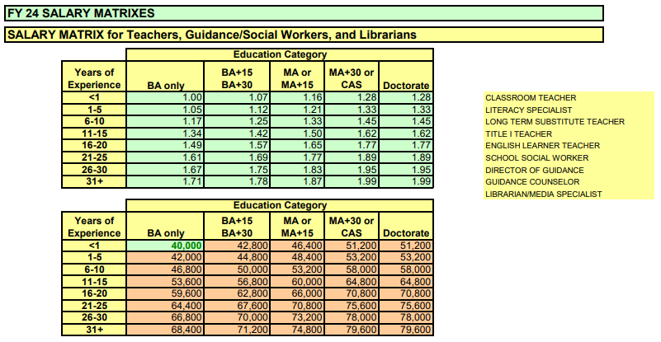
2023-2024 Updates to the School Funding Formula
The total cost of education reflects an increase to the Salary Matrix for Teachers, Guidance, Social Workers, and Librarians to a minimum of $40,000 in accordance with Title 20-A §15677.

Slide 43
FY 2023-24 Change to Benefits Percentages
The total cost of education further reflects an increase to the staff benefits percentages to better reflect actual expenses in accordance with Title 20-A §15678 and §15679; while spending on staff benefits as a percentage of salaries have continued to increase since the enactment of the EPS funding act, until now, these have not changed from the original benefits rates set in 2005-06.
Staff Positions | Former Benefits Percentage | New Benefits Percentage
Teachers, Guidance, Social Workers, Librarians & Health | 19% | 26%
Education & Library Technicians | 36% | 40%
Clerical | 29% | 40%
School Administration | 14% | 21%

Slide 44
Comparison of the Estimate cost of funding Public Education PK-12
FY 2023-2024 to FY 2022-2023
Preliminary ED 279 Estimate Only | Estimate FY 24 | Enacted FY 23
Total Operating Allocation (per Title 20-A §15683) | $1,566,469,714 | $1,534,093,140
Total Operating Public Charter School (per 20-A §15683-B) | $30,466,261 | $32,449,350
Total Other Subsidizable (per 20-A §15681-A) | $616,136,771 | $584,323,259
Total Operating & Other Subsidizable Allocation | $2,213,072,746 | $2,150,865,749
Total Debt Service Allocation (per 20-A §15683-A) | $104,788,669 | $99,403,683
Total Normalized Cost of Teacher Retirement (per 20-A §15689-C) | $64,953,243 | $50,222,361
Total Adjustments to Subsidy (excludes Min. Rec. Adjs.) (per 20-A §15689) | $9,286,591 | $10,404,353
Total Enhancing Student Performance & Opportunities (per 20-A §15672 & §15688-A) | $69,754,126 | $64,828,741
Total Targeted Education Funds (per 20-A §15689) | $83,416,466 | $87,038,673
Total Cost of Funding Public Education from Pre-Kindergarten to Grade 12 | $2,545,271,841 | $2,462,763,560
Total Estimate State Contribution | $1,400,174,513 | $1,354,519,958
Total Estimate Local Contribution | $1,145,097,328 | $1,108,243,602
Local Contribution Mil Rate | 7.29 | 7.10

Slide 45
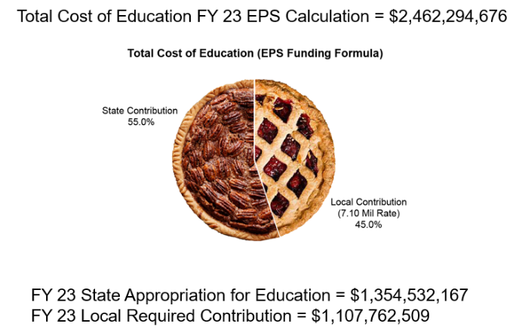
Why did the Local Share increase so much?
How Much Pie Do We Need?
Total cost of education increased by 3.37% from FY 23 to FY 24, as a result the increase to both the State Contribution at 55% and the Local Required Contribution at 45% was also 3.37%.

Slide 46
Subsidizable Student October 1 Counts by Grade Level FY 19 to FY 23 *Grade configurations in these charts match Section 2 of the ED 279 EPS Calculation of School Funding Reports.

Slide 47
Contact Information
Paula Gravelle Director of School Finance Phone: 207-624-6792 Email: Paula.B.Gravelle@Maine.gov | Ida Batista School Finance Manager Phone: 207-624-6795 Email: Ida.Batista@Maine.gov
Denise Towers Fiscal Review & Compliance Phone: 207-624-6863 Email: Denise.Towers@Maine.gov | Stephanie Clark Fiscal Review & Compliance Consultant Phone: 207-624-6807 Email: Stephanie.Clark@Maine.gov
Wendy Waltz School Finance Coordinator Phone: 207-624-6629 Email: Wendy.M.Waltz@Maine.gov | Tyler Rollins School Finance Fiscal Support Coordinator Phone: 207-624-6738 Email: Tyler.Rollins@Maine.gov

